Slide 1
About this deck….
Hello!
This deck is provided along with a collection of resources to help you host a generative AI themed event that will inform, educate and delight.
Synopsis:
This presentation provides a comprehensive overview of the key concepts, technologies, and techniques underlying generative AI. It covers the evolution from traditional machine learning to foundation models powered by transformer architecture and self-attention mechanisms. The presentation explains foundation models, vector embeddings, and customization methods like fine-tuning, continued pre-training, and retrieval augmented generation (RAG). It also discusses practical implementation using Amazon Bedrock and AWS services, making generative AI accessible to developers. With a mix of conceptual explanations and code examples, this presentation equips attendees with a solid understanding of generative AI and the ability to start leveraging it in their applications.
Level: 100-200
(*The level can be adjusted by the presenter to meet the needs of the audience.)

Slide 2
The Building Blocks of Gen AI

Slide 3
Gen AI
Vector Embeddings
Foundation Models
Supervised/
unsupervised learning
Hallucination
Transformer Architecture
Fine tuning
Continued Pre-training
Bedrock
RAG
Deep Learning
Labeled data
Notes:
So today we are going to be covering some terminology, definitions and also how you can achieve customizations using fine tuning, RAG and a bunch of other things to make sure we are all on the same page. We’re even going to touch on Transformer Architecture so you should walk out of here with greater understanding of the whats and hows even if you haven’t heard of them before. But before we understand the whats and hows, let’s first understand the why.
Because for many it may seem like generative AI came out of nowhere, some even dismissed it at the beginning as just another hashtag hype, but actually if you go back in history it’s not that difficult to see that gen ai is nothing but a very natural step in the evolution path and it’s been a long time coming.

Slide 4
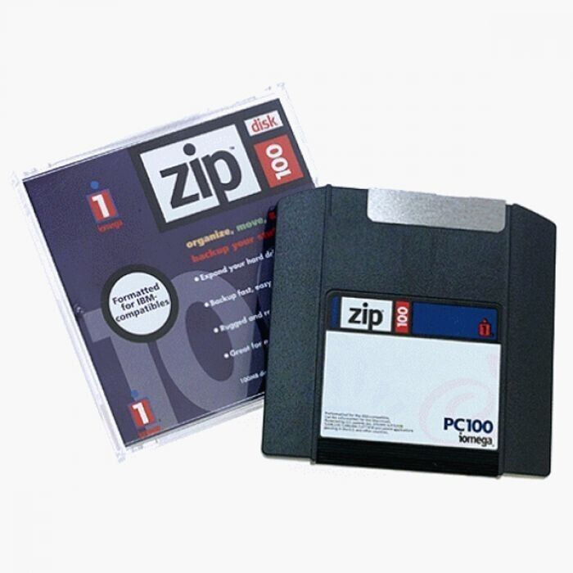
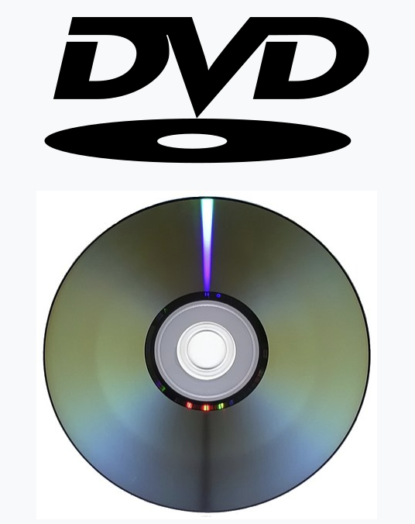
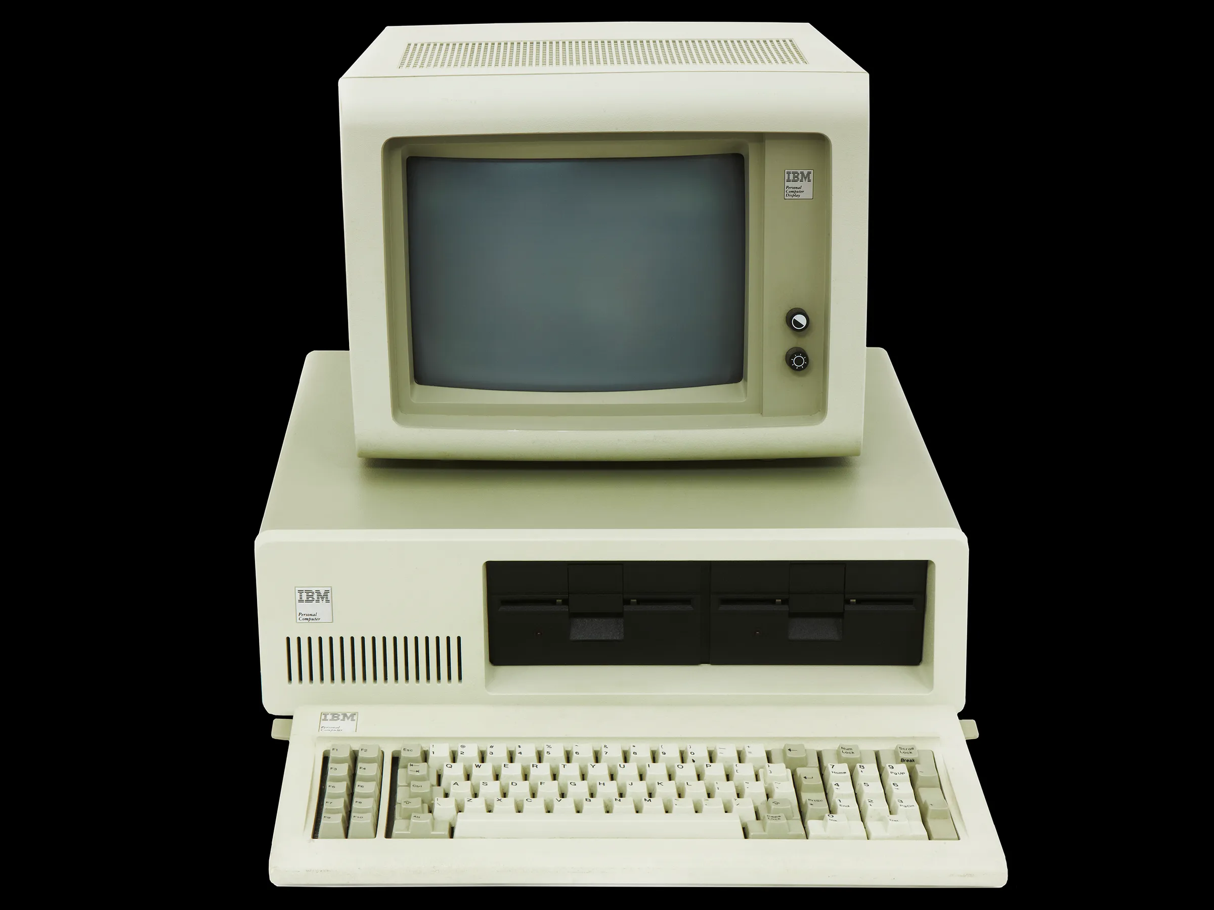
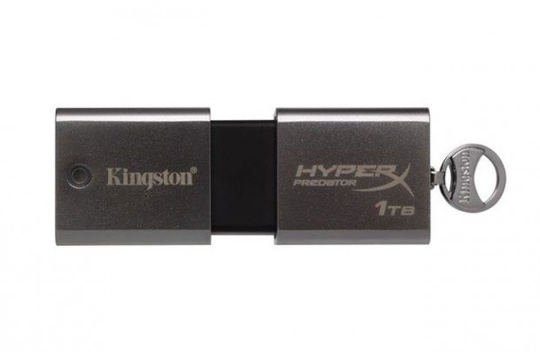
KB
MB
GB
TB
The first PC, the IBM PC, launches with 64KB RAM.
The first 100MB Zip Disks launched.
The first DVD is launched with 4.8GB capacity.
Kingston releases a 1TB usb stick.
1981
1994
1996
2013
Notes:
And that’s because the volume and immediacy of data has been growing exponentially throughout computer history.
If you were a child in the 80s, you may have been privileged enough to have one of those IBM PCs where you could play Frogger on a green monitor, which in hindsight, seems highly appropriate.
That computer had only 64KB of memory! So we went from KB, to MB, to GB, to TB and many companies, including AWS, have been dealing with PBs for quite a while now and some are even on the exabyte scale.
So what’s gonna happen when we reach the Zettabytes? Oh wait, you don’t have to imagine. And not just 1, but how about…

Slide 5
Around
120 zettabytes
of data will be generated this year
Source: Statista
Notes:
…120 Zettabytes? That is the amount of data that we are expected to generate globally in 2024 alone!
The point is that there’s too much information and there’s only so much that our little human brains can manage. It was always inevitable that we would need some kind of help to cope with this much data so we could break out of our human limitations. Otherwise we would be stuck with a lot of possibilities and ideas of what could be done but with no means of actually doing it.
But, of course, visionaries and industry leaders have been looking at this problem for a very long time and the answer was… (gesture for a cue to see if people fall for it and say “gen ai” ) … NOT generative AI, but…

Slide 6
AI
ML
Gen AI
Notes:
…ML: Machine Learning.
Machine learning has become synonymous with AI these days and most of the times people just say AI/ML. These terms have been so intertwined that sometimes people struggle to explain the difference if you ask them. It’s simple: Artificial Intelligence is the what and machine learning is just the how. Generative AI? It’s just not another how.
Ultimately all these technologies and evolutionary steps like gen ai want to achieve the same thing: the simulation of human intelligence. That is what artificial intelligence is pure and simple. It has always been like that whether you were a child in the 80s playing video games against an “AI” which behind the scenes was probably just a crude bunch of simple if and else statements , or maybe something ”fancier” a switch statement, or whether you are interacting with a chatbot to compose music together using natural language in 2024.
And AI has been going on for a long time now. Do you know when the first AI programs were written? It was created by the University of Manchester in England and it was an AI that played checkers which was followed by another one that played chess. See, everything goes back to video games! And that was all the way back in… 1951! That’s right, 1951.
And like anything, AI has been evolving since then including technologies that allowed us to apply machine learning to vast sets of data.

Slide 7
TRADITIONAL ML MODELS
Train
Deploy
Tasks
Text generation
Summarization
Labeled data
ML models
Info extraction
Q&A
Chatbot
Notes:
Traditionally, you would train one model for each task you wanted performed. You could already do text generation before generative AI came about but you had to specifically train a model for that. If you wanted to have a chatbot, you’d train another model. So on and so forth.
Typically you would label your data to make sure the model was optimized for the task you’re building it for.

Slide 8
Labelled data
Notes:
Labeling data effectively means tagging your data. Say you have a picture of a dog. You could store it with a tag saying ”dog” and ”animal” to tell the machine learning model that this is our human understanding of that picture so it can learn from us.
That process is known as…

Slide 9
Supervised Learning
Notes:
…supervised learning. Humans are the teachers and the machines take it from there.
The opposite of that, as you would expect is…

Slide 10
Supervised Learning
Unsupervised Learning
Notes:
…unsupervised learning.
You don’t label your data, you just provide the model with that dog picture and let the machine work out by itself. How does it do that? By deriving patterns from analyzing lots of data that you give to it.
All these techniques, however, have always been around. So what was the actual catalyst that made us leap forward into this new generative AI era? What happened? Well, Foundation Models happened.

Slide 11
FOUNDATION MODELS
Pretrain
Adapt
Tasks
Text generation
Unlabeled data
FM
Summarization
Info extraction
Q&A
Chatbot
Notes:
Foundation Models are machine learning models that are trained on vast amounts of data so they contain a vast amount of general knowledge and can effectively be used for all kinds of tasks.
This simplifies everything. With traditional ML, you need to dedicate a lot of time on data science workstreams to make the most of AI which is still suitable for AI companies, but Foundation Models provide a layer of abstraction over all that while making themselves available as single know-it-all brain, making AI accessible for everyone.
Ok, but why wasn’t that possible before? Well, that is because of advancements in…

Slide 12
Deep Learning
Notes:
…deep learning architecture.
It is called deep learning because the model has many layers that it goes through until it can work out the meaning from the input. Think about it like this, this is very similar to what happens when you come across a familiar smell, for example, and you dig through your brain until you pinpoint that memory of what it reminds you of , that’s how deep learning architecture works. And much like any architecture it kept evolving over time.
But in 2017, a major breakthrough happened. And that was the publication of the paper…

Slide 13
Attention Is
All You
Need
Notes:
“Attention Is All You Need”. And it was based on this paper that some incredibly smart people developed the revolutionary Transformer architecture.

Slide 14

Transformer Architecture
Self-attention
Multi-Head Attention
Positional Encoding
Notes:
…self-attention.
Attention is a mechanism which attempts to emulate human’s cognitive attention. Effectively it’s an algorithm that tries to figure out which parts of a sentence are more important and which words or bits of words it should focus on to understand the meaning with accuracy. Exactly the same process that your brain is going through right now as you hear me speak and you are discarding certain things while hanging on to others so you can keep up.
Transformer architecture proposed a new way of calculating attention called self-attention which basically means that each element of a sequence can pay attention to itself in relation to other things in that the sequence alone whereas the traditional attention mechanism created dependencies with things outside of the sequence which meant that there were bottlenecks and the whole thing was very sequential and not every efficient.
And that bring us to the second revolutionary aspect…

Slide 15
Transformer Architecture
Self-attention
Multi-Head Attention
Positional Encoding
Notes:
…self-attention.
Attention is a mechanism which attempts to emulate human’s cognitive attention. Effectively it’s an algorithm that tries to figure out which parts of a sentence are more important and which words or bits of words it should focus on to understand the meaning with accuracy. Exactly the same process that your brain is going through right now as you hear me speak and you are discarding certain things while hanging on to others so you can keep up.
Transformer architecture proposed a new way of calculating attention called self-attention which basically means that each element of a sequence can pay attention to itself in relation to other things in that the sequence alone whereas the traditional attention mechanism created dependencies with things outside of the sequence which meant that there were bottlenecks and the whole thing was very sequential and not every efficient.
And that bring us to the second revolutionary aspect…

Slide 16
Transformer Architecture
Self-attention
Multi-Head Attention
Positional Encoding
Notes:
…Multi-Head Attention.
This is a module that happens a few times in the architecture pipeline as you can see and it’s responsible for calculating the attention scores for each of the elements in the sequence. However, because we’re now using self-attention it can make use of parallel processing to calculate each element independently at the same time.
This new ability to process attention scores in parallel gave us a huge leap in efficiency and is largely responsible for this new age of Foundation Models.
Lastly, something that is a bit easier to grasp but super clever when you dig deeper into it…

Slide 17
Transformer Architecture
Self-attention
Multi-Head Attention
Positional Encoding
Notes:
…Positional Encoding which means that each element of a sequence have information about their place in the sequence embedded with them so they can carry it around and any of the modules that they go through can retrieve that information easily.
Like I said, super geeky, super cool. However, you don’t need to learn any of this to start using AI today because what Transformer Architecture allows us to do is train Foundation Models very efficiently.

Slide 18
Foundation Models
Claude
Jurrasic
Mistral
Amazon Titan
Embed
Stable Diffusion
Llama
Command
GPT
Notes:
… and that is why we are seeing more foundation models coming out recently than javascript frameworks back in the the day and we never thought we’d break that record!
The ones listed here really are just a few of them. Some highlights are…

Slide 19
Foundation Models
Claude
Jurrasic
Mistral
Amazon Titan
Embed
Stable Diffusion
Llama
Command
GPT
Notes:
Claude 3 which has 3 models available: Haiku, Sonnet and Opus. All of them are multimodal by the way, which means that you can give them text or image as input.

Slide 20
Foundation Models
Claude
Jurrasic
Mistral
Amazon Titan
Embed
Stable Diffusion
Llama
Command
GPT
Notes:
Mistral has quite a few open-source models of various kinds including Mixtral 8x7B which is a sparse mixture of experts model and a few other ones which are very popular.

Slide 21
Foundation Models
Claude
Jurrasic
Mistral
Amazon Titan
Embed
Stable Diffusion
Llama
Command
GPT
Notes:
… and, of course, AWS also has their own family of models called Amazon Titan which includes two LLMs for text generation, Text Lite and Text Express, also Image Generator, as well as a few others.
While AWS certainly encourages you to try the Amazon Titan models, they believe that “no one model will rule them all”, as they say, not even theirs.
What they mean is that there is not one catch-all solution and you should try different ones to solve different problems since every one of these models have different strengths and are better at different things.

Slide 22
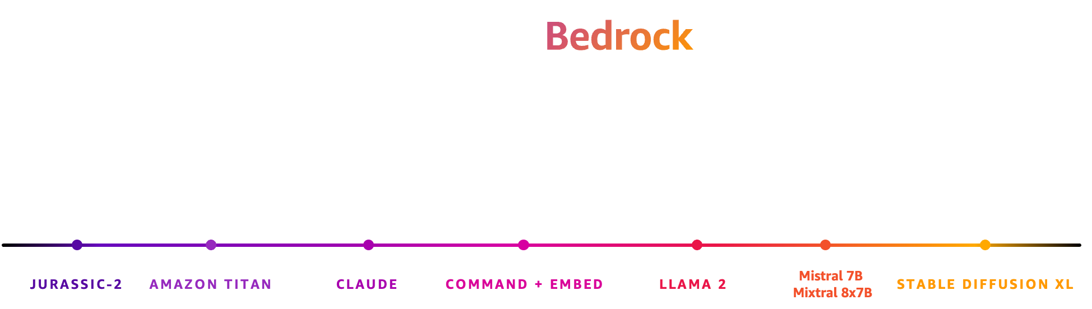
Notes:
That is the philosophy behind Amazon Bedrock which is a serverless portal to multiple Foundation Models that you can use in AWS which includes the Amazon Titan models as well as many more from various partners such as Anthropic, Meta, Cohere and others. You can use it to pick and mix whichever Foundation Model you need at any given time to solve your problems.
That in itself is pretty awesome, however, remember that these models hold general knowledge. Granted it’s a vast amount of general knowledge but, much like humans, while this allows them to understand even things they haven’t encountered yet, you probably don’t want to give them a scalpel to perform surgery until you put it through medical school first.
And that is a very important to consider because when you develop with gen ai to need to deal with…

Slide 23
Hallucination
Notes:
…hallucinations.
Kind of like humans too, machines can get too eager to please and a model may decide to give you an impulsive answer even if it doesn’t know for sure that what it’s saying is entirely correct.
Whenever that happens we say that the model is hallucinating. Effectively, hallucinations are errors, if you will. It’s when machines make up facts. (mmm once again, not so different from humans coming to think of it).
How do you mitigate hallucinations? Through customization.

Slide 24
Customizing Models
Fine
tuning
Continued Pre-Training
RAG
(Retrieval Augmented Generation)
Notes:
So, taking from the previous example, say you’re developing a chatbot that can guide surgeons during surgery then you would train it on a large amount of specialized medical data to make sure that it doesn’t make up steps.
Similarly, if you want to develop a chatbot that helps your customers to make purchases on your web site, you want to make sure that the foundation model powering that chatbot knows about your products, your prices, your stock, and perhaps promotions and offers you may be having at the time.
There are currently three main customization techniques: fine tuning, continued pre-training and RAG.

Slide 25
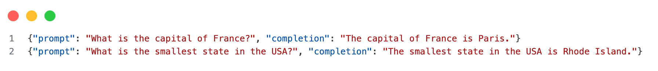
Fine Tuning
My Customized Model
User prompt
Foundation Model
Notes:
Fine tuning is fairly simple. It’s a form of supervised learning, so if you remember from earlier, this means we are going to label our data and give it to the model so it can learn from us.
The way you do this is with fine tuning is by providing datasets containing examples of prompts and what you expect the correct answer to be if someone asked you that question. Here we are providing it with a set of geography questions and answers so maybe this could be used to create an app that helps students or maybe just to generate quiz trivia questions.
You give that to the model and then you end up with a customized version of the foundation model which becomes the one you actually use in your applications.

Slide 26
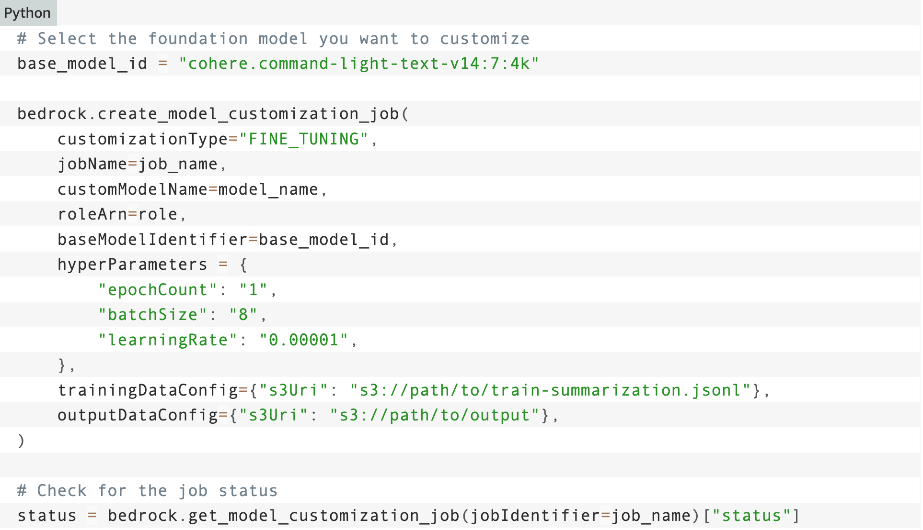
Fine Tuning
Using Boto3 (AWS Python SDK) and Amazon Bedrock
Notes:
This is all the code you need to create a fine tuning job. Even if you don’t know Python I hope that you can appreciate the simplicity and how far we’ve already come with generative AI.
In this specific demo I’m using Amazon Bedrock and the AWS SDK for Python which is called Boto3 .
And there are only really 3 things that you need to worry about here.

Slide 27
Fine Tuning
Using Boto3 (AWS Python SDK) and Amazon Bedrock
Notes:
Remember that you have many different models to choose from with Bedrock, so the first thing you do is select the model you want and look up their id.
In this case we’re using a foundation model called Command and we have put its id there.

Slide 28
Fine Tuning
Using Boto3 (AWS Python SDK) and Amazon Bedrock
Notes:
Then you call a create_model_customization_job method which is pretty self-explanatory, and within it you set the attribute called customizationType to “FINE_TUNING”

Slide 29
Fine Tuning
Using Boto3 (AWS Python SDK) and Amazon Bedrock
Notes:
Lastly all you need to do is tell it where your data is stored. In this case, it’s on Amazon S3.
Once the job is complete, it will generate an endpoint that you can then use for your application.
And done! Simple, right?

Slide 30



Continued Pre-Training
User prompt
Foundation Model
My Customized Model
Notes:
As an alternative to Fine Tuning you can use what is called Continued Pre-Training and this is a way to train your model through unsupervised learning.
So, if you remember, with unsupervised learning we don’t label our data, we’re just going to give our unstructured data to the model as is.
We will then allow the model to be re-trained but it will add all the provided data as part of its general knowledge. It’s less effort than fine tuning, but it could potentially take more time, resources and costs depending on your use case so you should consider it against fine-tuning on a case-by-case basis.

Slide 31
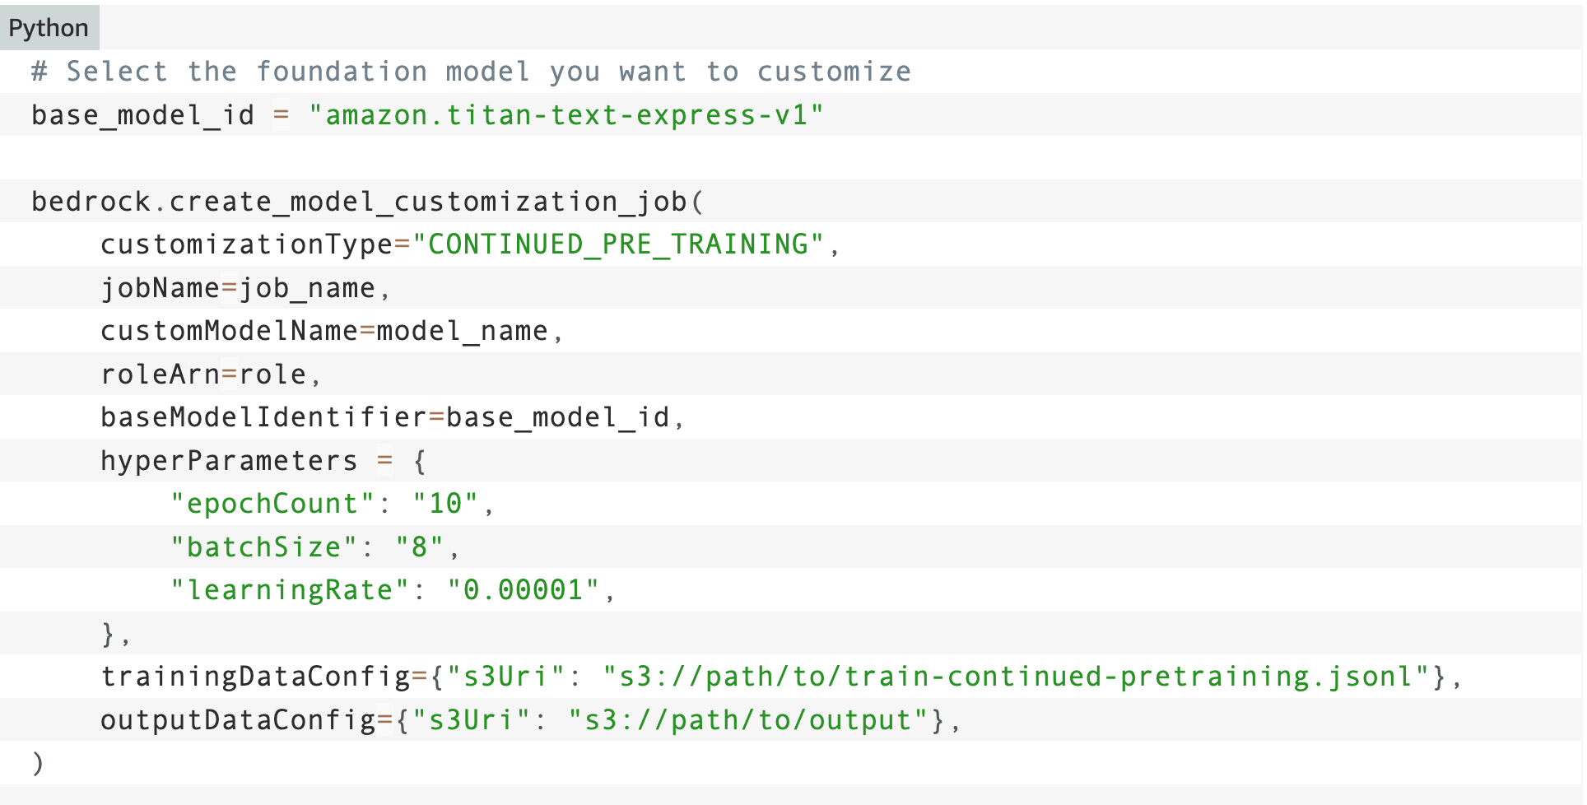
Continued Pre-Training
Using Boto3 (AWS Python SDK) and Amazon Bedrock
Notes:
And much like fine tuning, it’s pretty easy to get this going.
Here I’m using boto3 again and this time I’m using one of models from AWS, Amazon Titan Text Express.
Once again we just need to add the model id in there.

Slide 32
Continued Pre-Training
Using Boto3 (AWS Python SDK) and Amazon Bedrock
Notes:
Then I call the same method again to create a customization job, but this time around I give set the value of customizationType to CONTINUED_PRE_TRAINING.

Slide 33
Continued Pre-Training
Using Boto3 (AWS Python SDK) and Amazon Bedrock
Notes:
Then finally you point to where you data is. In this case, I took this screenshot from a demo where I have a json file but the file only contains prompts not the answers to the prompts so it’s still unsupervised learning as I’m not giving the machine any hints.
And that’s it.
If that’s still not simple enough for you though, that’s one more option.

Slide 34
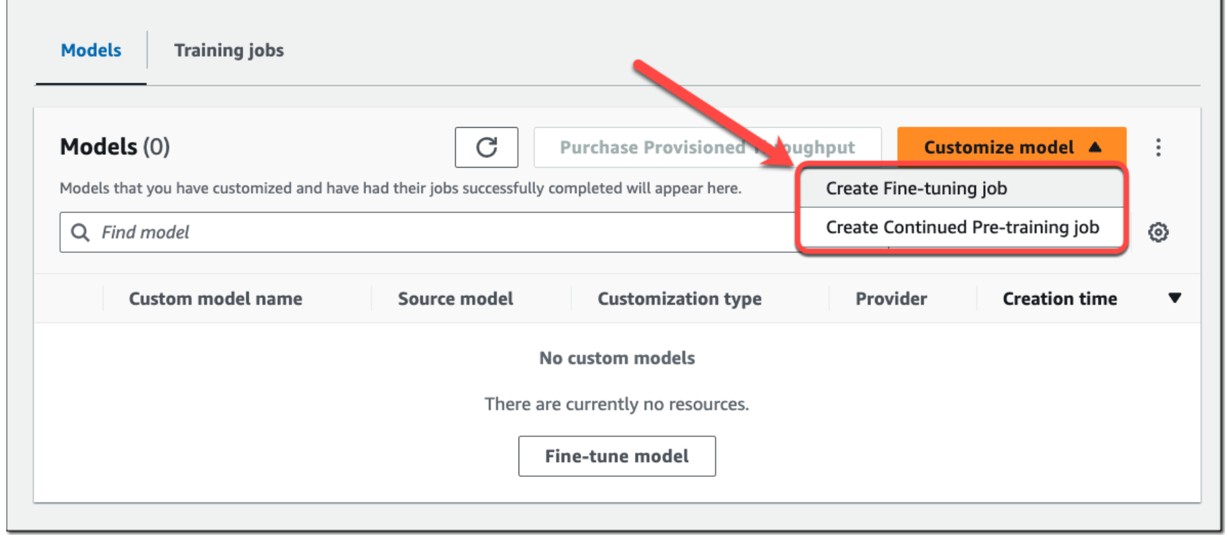
No code option via the Amazon Bedrock UI
Notes:
And that is the UI. You can use the Bedrock Console to create these customization jobs with no code so you can set up your fine tuning or continued pre-training jobs just by doing click-y click-y.

Slide 35

“Are there any sales on computer desks?”
Example Shop Database
RAG
Example Shop Chatbot
“Example Shop is offering 20% off on all furniture items for the next two weeks. Are there any sales on computer desks?”
“Yes, you can get 20% computer desks if you purchase them within the next two weeks.”
Foundation Model
Notes:
Alright, that brings us to the last of the main customization techniques we use today: RAG.
Who here has heard of RAG?
Who here has implemented RAG?
Ok, so the objective of RAG is to intercept prompts and add information to that prompt taken from your own data sets to create rich accurate customized context before sending them to the model.
How does RAG actually perform that similarity search in our databases to determine what information is relevant or not to add to the prompt? It uses something called…vector embeddings.

Slide 36


Vector Embeddings
[0.543, 0.234, 0.874]
[0.543, 0.234, 0.663]
bottle
liquid
water
bottle
liquid
coke
Notes:
Vectors, or vector embeddings, or just embeddings are the same thing, you can use those terms interchangeably. They sound fancy, but what if I told you they’re just arrays? Does that sound more familiar? Well, they are, it’s as simple as that.
The difference is they can only store numbers and each one of them represent something. For example, if you put the picture of a water bottle through a vectorizer it will interpret the content and create and array with numbers representing various aspects of that object.
Each item in the array is called a dimension. So in this case we have a 3-dimension vector. The more dimensions you have the more you can describe things and potentially increase accuracy when determining how similar things are to each other.
Easy, right?

Slide 37
Knowledge base
RAG
Vector
Database
User prompt
Vectorizer
Vectorizer
User prompt
+
retrieved text
retrieved text
retrieved vectors
Foundation
Model
Final prompt
Notes:
So here’s how they’re used in RAG architecture.
The first thing we do is store your unlabeled data somewhere. This could be, for example, Amazon S3.
Then we need to put that data through a Vectorizer, that is, something that will convert our data to vectors. You could use, for example, Amazon Titan Text Embeddings which is one of the foundation models available through Bedrock.

Slide 38
Knowledge base
RAG
Vector
Database
User prompt
Vectorizer
Vectorizer
User prompt
+
retrieved text
retrieved text
retrieved vectors
Foundation
Model
Final prompt
Notes:
Then we’re gonna store these vectors representing the data from our knowledge base into a vector database. Why? Because vector databases understand that vector embeddings are not just an array of numbers and treat them as vectors. This means they can do similarity searches and we can ask questions such as “how similar is this water bottle to this coke bottle?”
There are many options for storing your vectors on AWS including within databases you may already use for other purposes. For example, if you already use PostgreSQL for your relational data you can enable the very popular pgvector extension or if you use DocumentDB you can create vector indexes.

Slide 39
Knowledge base
RAG
Vector
Database
User prompt
Vectorizer
Vectorizer
User prompt
+
retrieved text
retrieved text
retrieved vectors
Foundation
Model
Final prompt
Notes:
That’s the prep work done.
Now we start our application workflow. You send a prompt to your gen ai application as usual, but wait, this time it doesn’t get fed straight to the model. Instead, our prompt is also vectorized using the same Vectorizer we used for our knowledge base.

Slide 40
Knowledge base
RAG
Vector
Database
User prompt
Vectorizer
Vectorizer
User prompt
+
retrieved text
retrieved text
retrieved vectors
Foundation
Model
Final prompt
Notes:
This is then used to do a similarity search against our knowledge base vectors. The objective here is to try to improve our initial prompt by finding things in our knowledge base that can add context by adding more information or facts that the foundation model doesn’t know about.

Slide 41
Knowledge base
RAG
Vector
Database
User prompt
Vectorizer
Vectorizer
User prompt
+
retrieved text
retrieved text
retrieved vectors
Foundation
Model
Final prompt
Notes:
If information is found and retrieved from the vector database it is then converted back into normal text. Some vector databases embed this information alongside the vector storage or keep a mapping to the original source.

Slide 42
Knowledge base
RAG
Vector
Database
User prompt
Vectorizer
Vectorizer
User prompt
+
retrieved text
retrieved text
retrieved vectors
Foundation
Model
Final prompt
Notes:
We are then ready to merge our initial prompt with whatever information we retrieved from our knowledge base.
Depending on how much text you end up with you may exceed the context window limits imposed by the foundation model or service that you’re using. This is one of the considerations you have to keep in mind when implementing RAG solutions.

Slide 43
Knowledge base
RAG
Vector
Database
User prompt
Vectorizer
Vectorizer
User prompt
+
retrieved text
retrieved text
retrieved vectors
Foundation
Model
Final prompt
Notes:
We then finally send the final prompt to the model.
If our initial prompt was something like “Are there any discounts on computer desks?”, combined with the information retrieved from our knowledge base, the final prompt may look something like this:
“Example shop is offering 15% discount on furniture items for the next two weeks. Are there any discounts on computer desks?”
The model then may answer something like “Yes, you can get 15% computer desks if you purchase them from Example Shop within the next two weeks.”

Slide 44
Knowledge base
RAG
Vector
Database
User prompt
Vectorizer
Vectorizer
User prompt
+
retrieved text
retrieved text
retrieved vectors
Foundation
Model
Final prompt
Notes:
Now if this looks like a lot for you, the good news is that, much like the other customization options, it’s much simpler to implement than it seems and the code can be very straight forward.
However, if you prefer to get a full RAG architecture solution done for you, then…

Slide 45
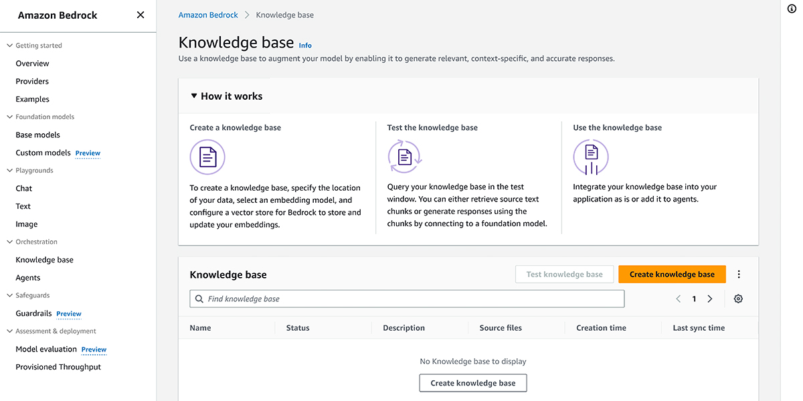
Amazon Bedrock Knowledge base
Notes:
… you can just use the Knowledge base feature in Bedrock which builds the whole RAG pipeline for you. You just need to point it to where your data is stored and decide whether you want to allow it to create and configure a vector database for you or just point it to an existing one if you’d rather take care of that yourself.
It will then give you an endpoint that you can use to send your prompts to and it’ll take of the rest.
Beautiful, right?

Slide 46
Gen AI
Vector Embeddings
Foundation Models
Supervised/
unsupervised learning
Hallucination
Transformer Architecture
Fine tuning
Continued Pre-training
Bedrock
RAG
Deep Learning
Notes:
And with that, we have reached our destination!
I hope you enjoyed our quick tour of gen ai and have maybe learned something new today.

Slide 47

Share your feedback about the session and generative AI services
1 min Community Survey
Notes:
Dear speaker: we would really appreciate if you keep this slide and get attendees to answer it. It takes less than 1 minute, and it will help us a lot support the community better and addressing their feedback.
Thanks a lot.
AWS Community team

